Slide 1
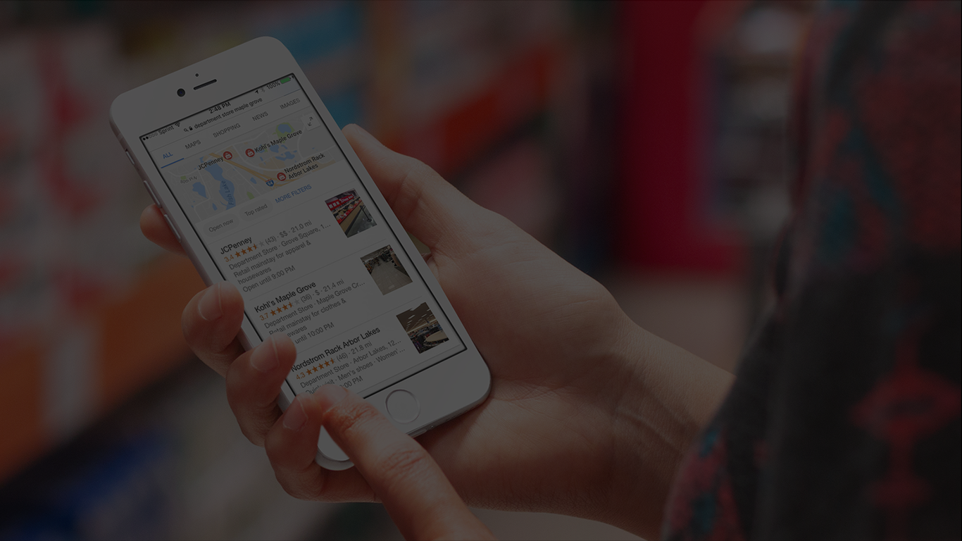

POWER YOUR BUSINESS
  With Customer Feedback & Online Reviews

Slide 2
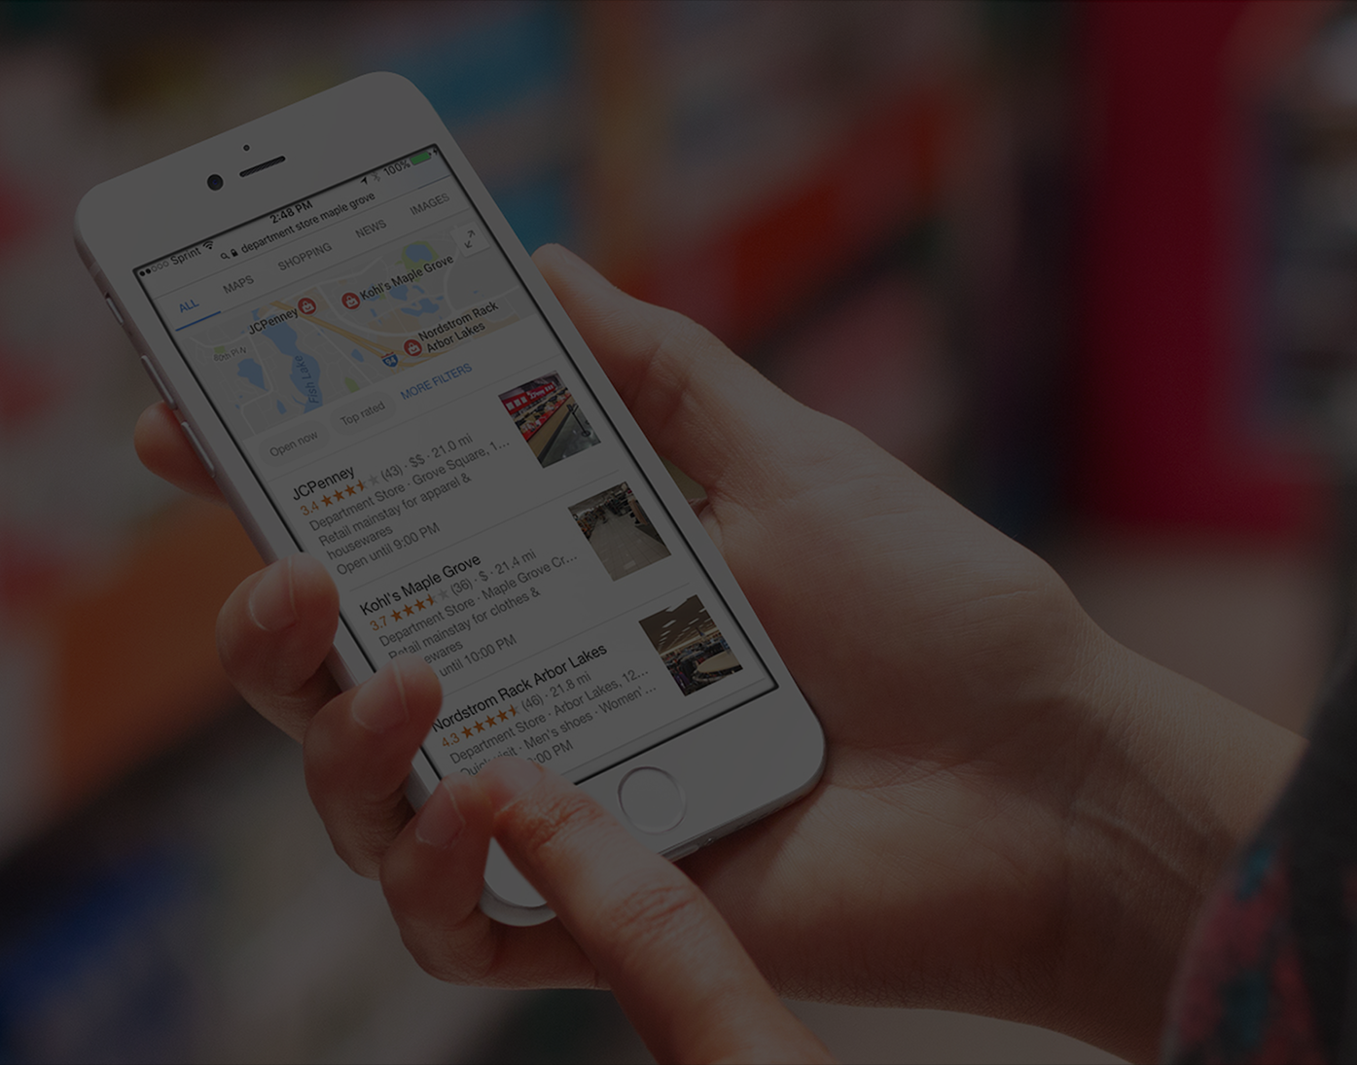

BENEFITS
    Grow your revenue and marketing by impacting SEO, reviews, and social proof
    Reduce negative reviews by making feedback easy for your customers
    Save time and money with a simple, robust and actionable solution

Slide 3

How Important Are Reviews
For A Local Business?
“We can’t go there, they don’t have that many stars.”

Slide 4
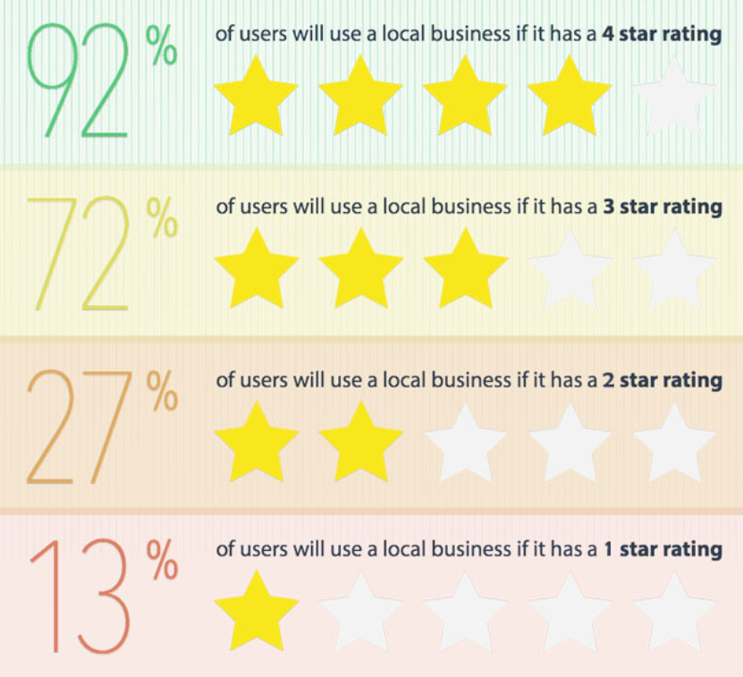
More Stars = More Customers
Having more positive, online reviews will help boost your local ranking and convert more leads to customers.
Research and Image by BrightLocal.com
3.5x as Many Customers

Slide 5

How Customers Search Today
They quickly scan for reviews on each listing
Looking to see what other people are saying
Social signals are recent customers talking about a business and sharing their experience openly online

Slide 6
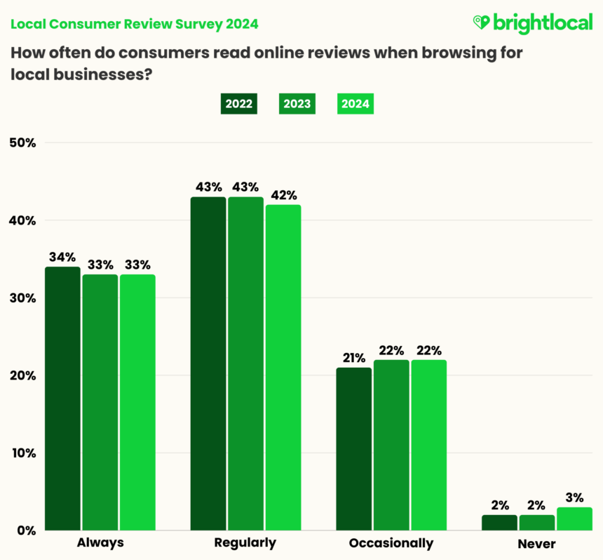
Key Findings:
Consumers regularly read online reviews when choosing a business. Only 3% of consumers say they ‘never’ read online reviews, reflecting how ingrained reviews are with most consumers.

Slide 7
Proprietary, AI-powered system helps generate positive reviews by leveraging your recent customers.

Slide 8



CAPTURE
MANAGE
MARKET
        Tools to help you capture feedback, reviews, and ratings all in one place.
        Email or SMS
        Review Monitoring for
        200+ sites
        Kiosk Mode and Feedback URL
        Google Q&A monitoring
        Branded Page
        Actions that help you manage customer experience, users, insights, and reporting.
        Receive new feedback and review notifications
        Read & Respond
        Auto-tagging of themes
        View reporting
        Insights Report
        Use feedback and reviews
        to market your business, improve SEO, and win new customers.
        Review Widget displays
        reviews on your website
        Add social proof with Conversion Pop-up
        Generate 3rd-party reviews
        Impact SEO and get review stars in search results

Slide 9

CAPTURE
      Let’s look at how we capture customer feedback and
      reviews from your customers and the web

Slide 10




CAPTURE
    Email or SMS Requests
      Single or list upload
      We help you proactively ASK for feedback and reviews
    TextBack
      Customer-activated feedback
        Your customer shops with you, buys from you, or completes a service with you and we help you ask them for feedback and online reviews.
        We have numerous proactive methods to help engage as many of your customers as possible.
        Email and SMS requests have many options including sending us your contact list so we can format and upload it on your behalf.
    Kiosk Mode
      iPad or smartphone
    Integrate
      API, Zapier, or Webhooks

Slide 11
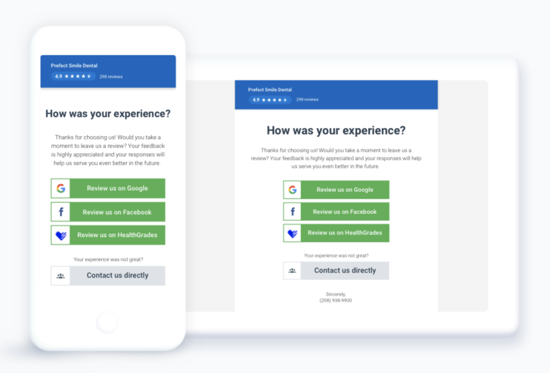
CAPTURE
      Simple 1-Step process that requests 3rd party reviews or direct contact if their experience was less than satisfied.

Slide 12




CAPTURE
    Feedback URL
      Share link to social or anywhere
      Make feedback EASY for your customer with passive entry
    Leave Feedback Button
      Display in online widget
        Offering a number of easy and accessible entry points for a customer to give you feedback is key.
        Reduce negative reviews by showing you are a “feedback first” business.
    Email Marketing
      Mail Merge Embed
    Feedback Locator
      For franchises & multi-locations

Slide 13























CAPTURE
      Monitor new 3rd-party reviews on sites like Google
        We monitor the sites you select on a daily basis to detect new online reviews.
        Email notifications are sent and all of your review data is captured in our system so you can learn, report, and respond. We offer over 200 sites to choose from.

Slide 14
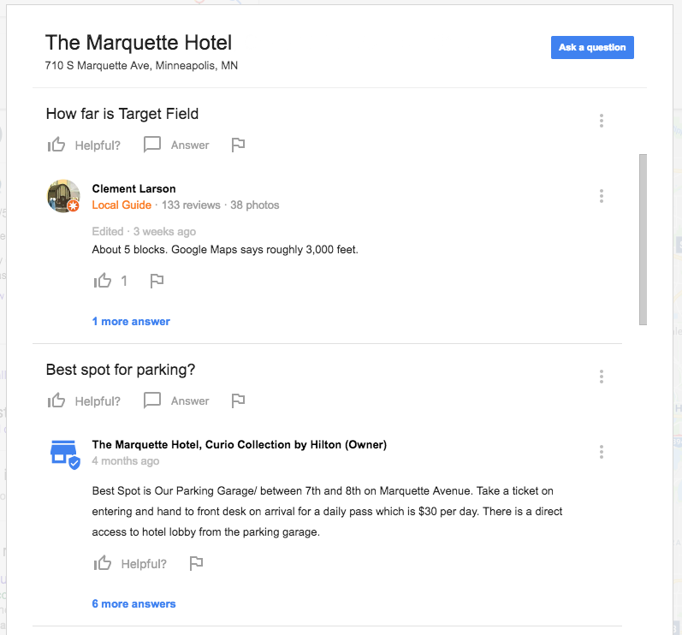
CAPTURE
      Monitor Google Questions
      & Answers
        Google’s new Q&A feature appears in search results. It allows consumers to ask and answer questions about your business.
        Monitor Google Q&A to be notified when there is a new question or answer about your business allowing you to manage this highly visible feature and answer questions in a timely manner.

Slide 15

MANAGE
      Features, tools, and reports so you can learn from,
      manage, and respond to your customers.

Slide 16
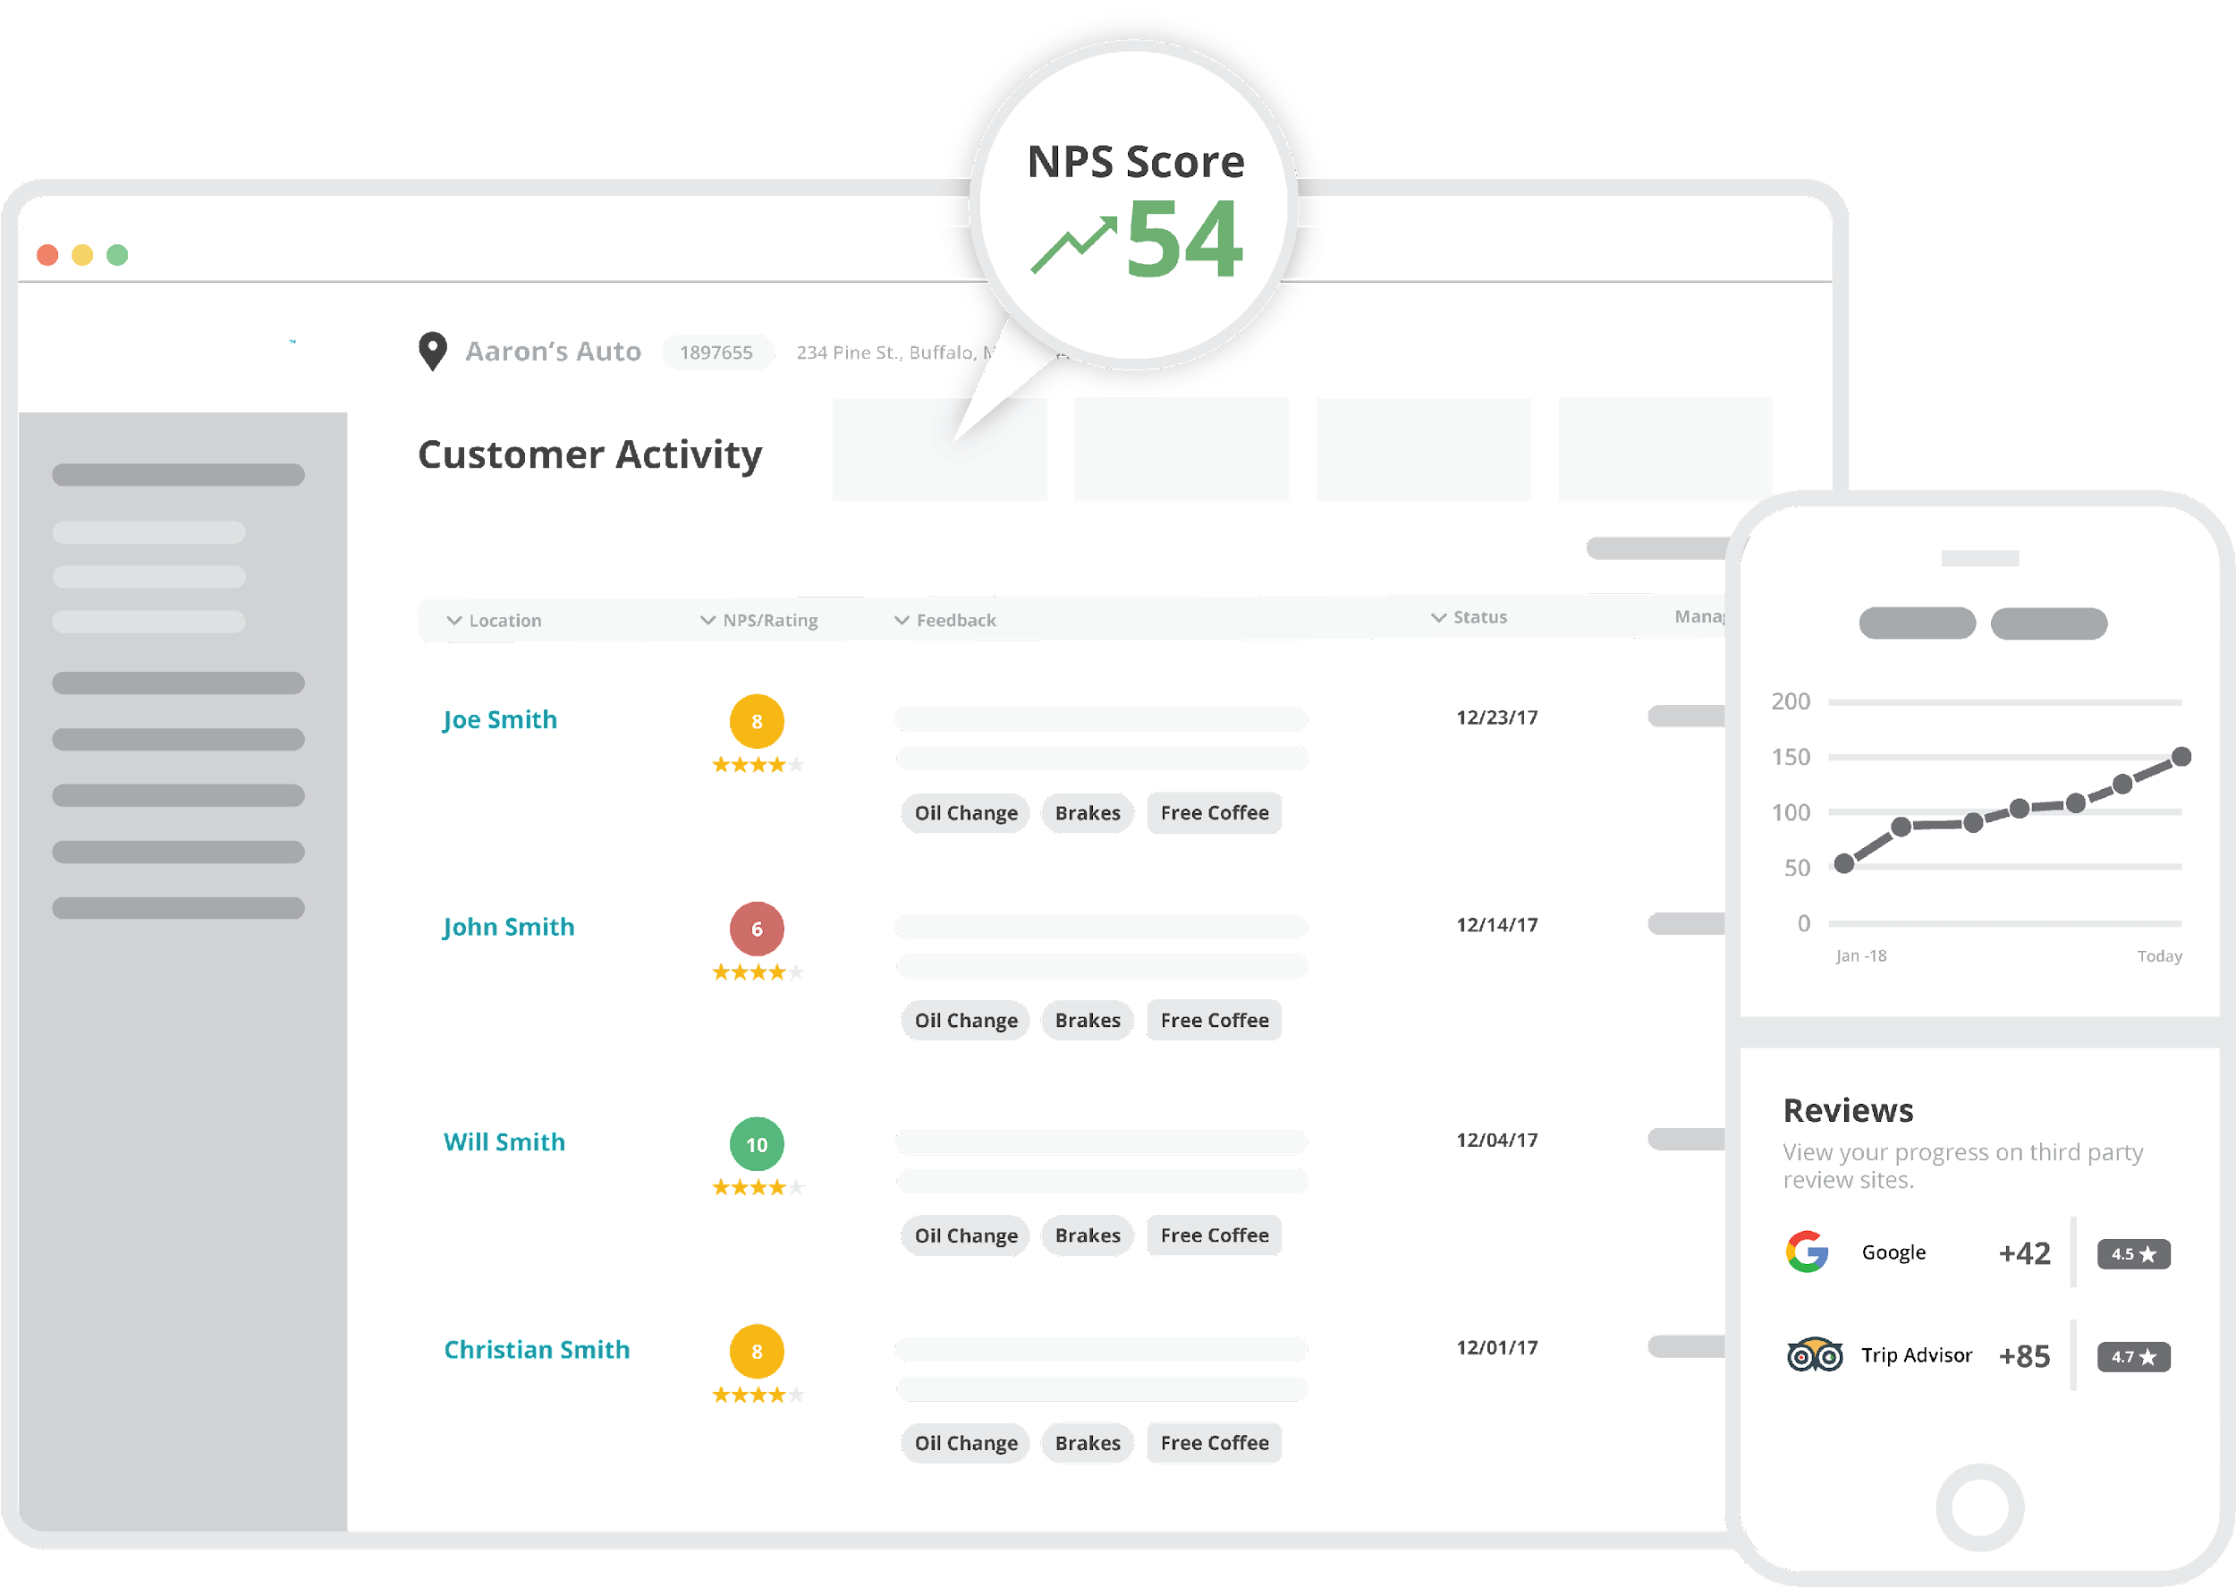
MANAGE
      Customer Activity puts all of your customers in one place
        Tap into the live stream of your customers and their experiences.
        See all of your customers in a single source view with endless options on how you can filter and take action.
        Read customer feedback, respond, view statuses, and more.

Slide 17
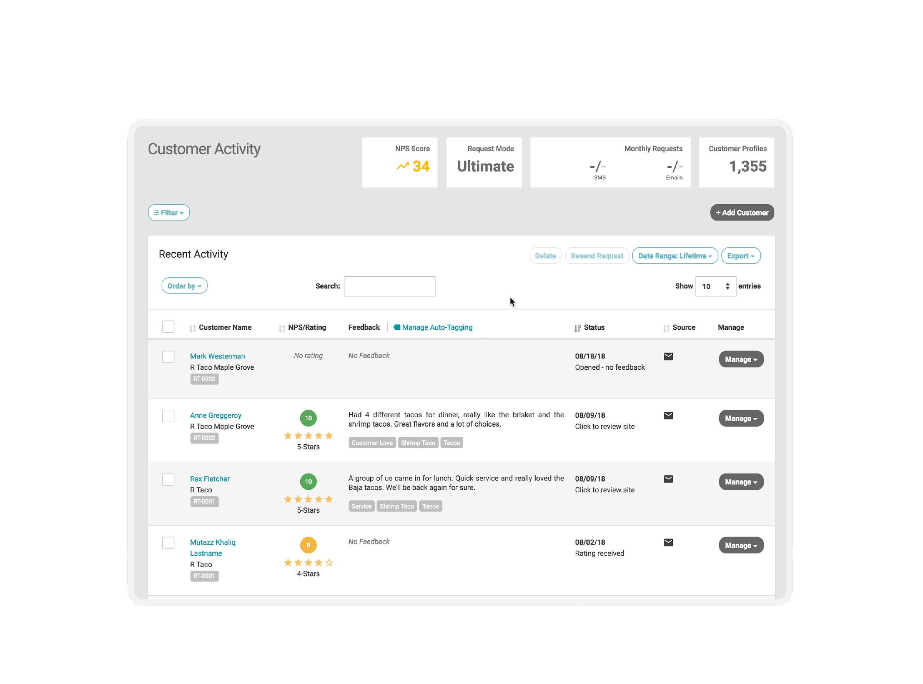

MANAGE
      Customer name and what location they are from

Slide 18
MANAGE
      NPS Score &
      5-Star Rating Score

Slide 19
MANAGE
      Customer Feedback Content

Slide 20
MANAGE
      Last Action Taken…
      10 Statuses So You Know What Took Place

Slide 21
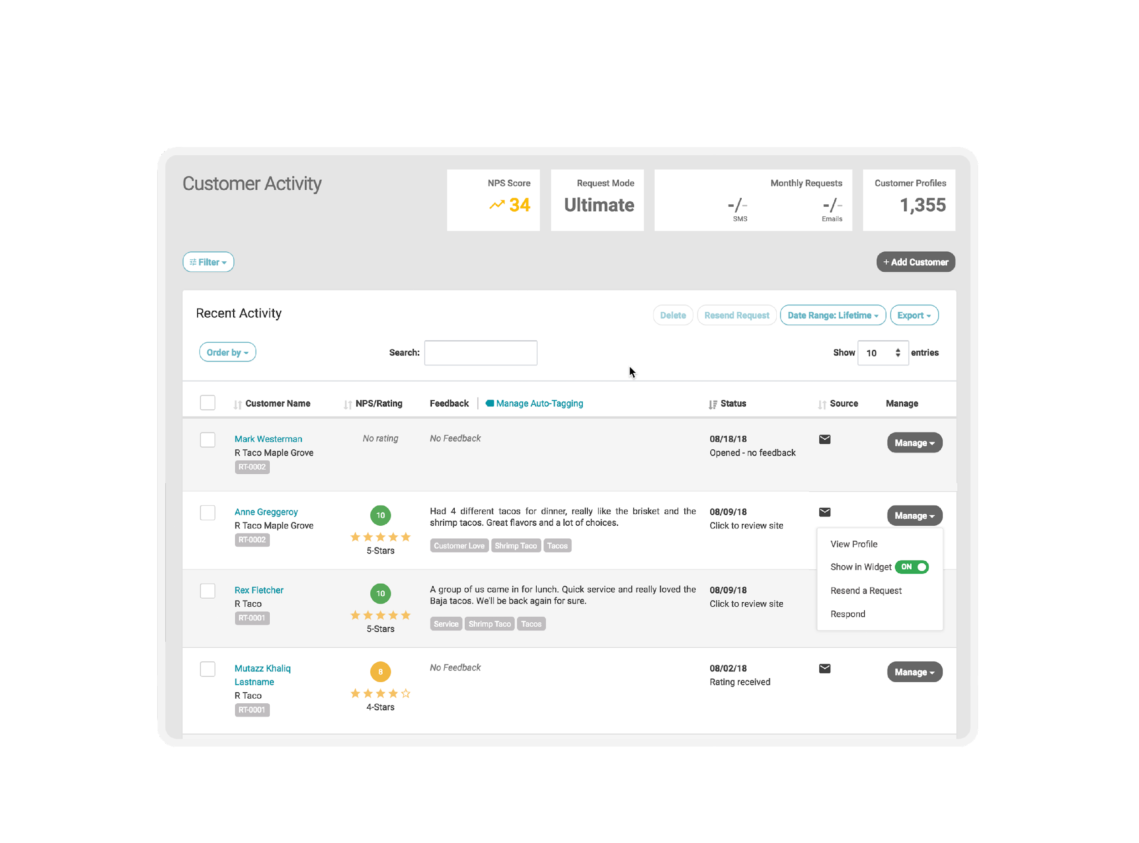
MANAGE
      Options To Manage…
      Respond To Customer, View Profile, Add To Review Widget

Slide 22
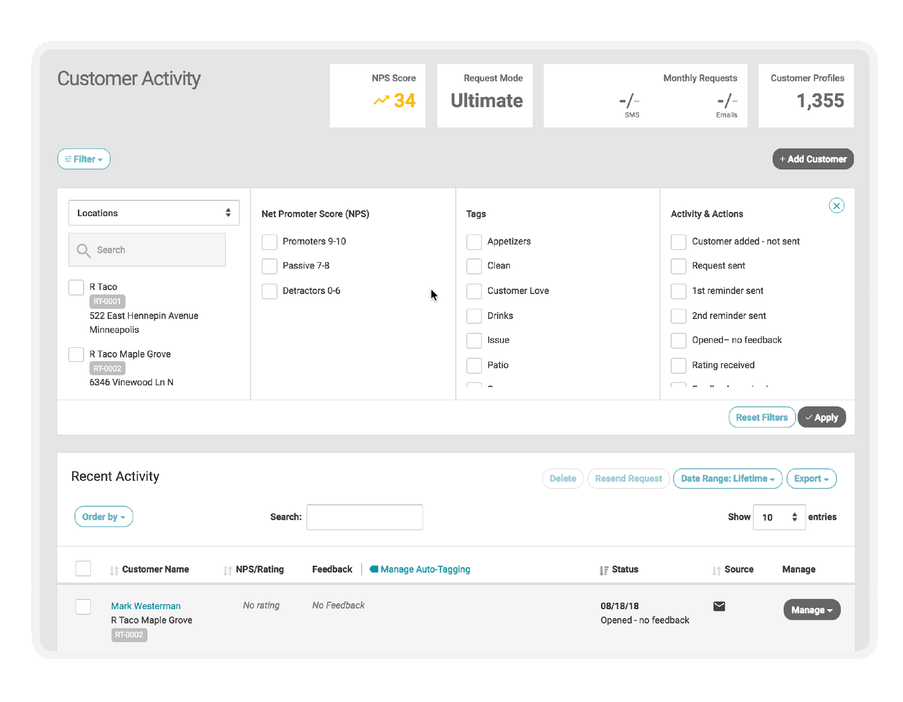
MANAGE
      High Powered Filtering System To View The Data And Actions How You Want

Slide 23
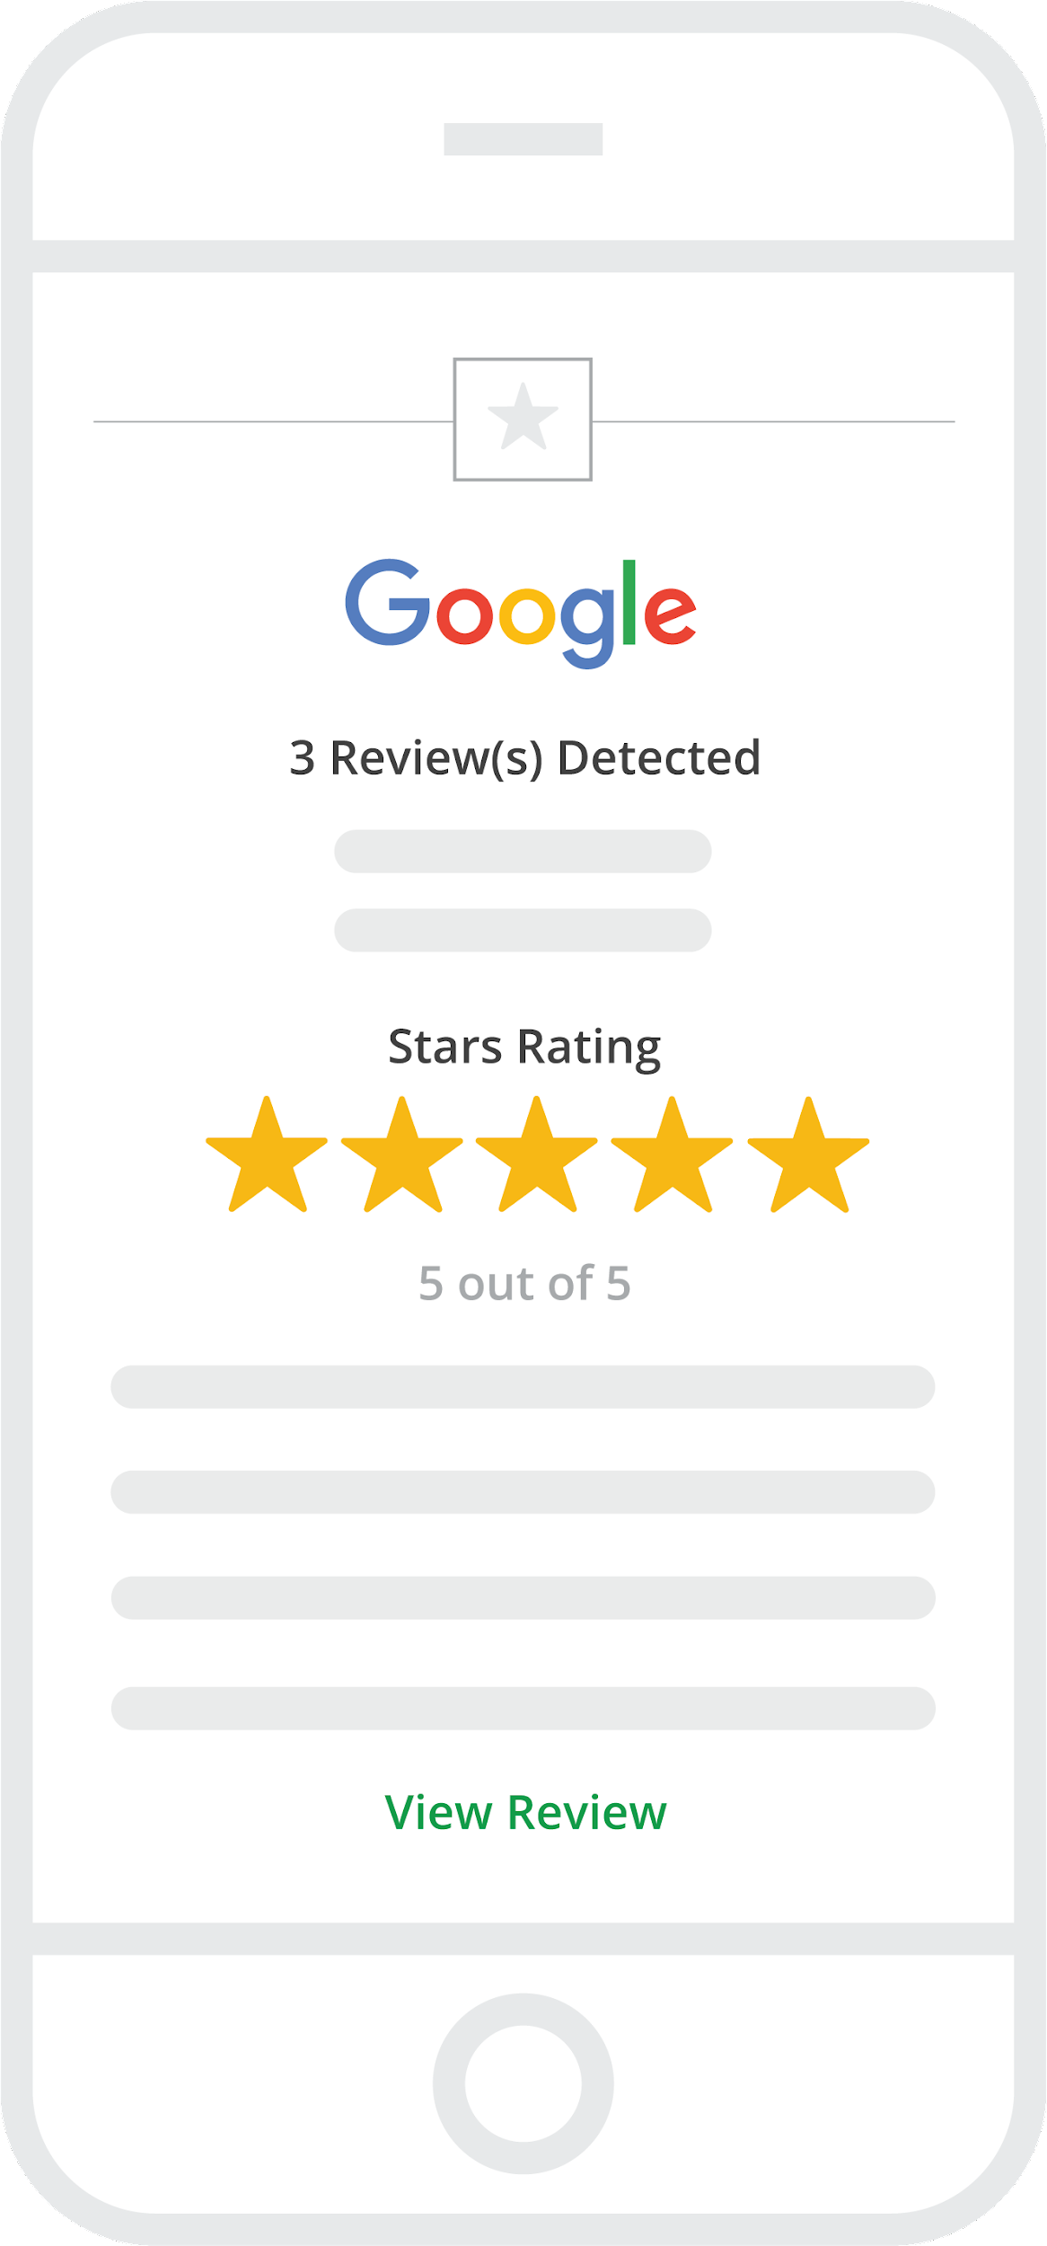
MANAGE
      Receive email notifications when
      new interactions happen
        Our service not only captures customer data for your account, we send email notifications for specific actions including:
        New customer feedback – good or bad
        New 3rd-party online reviews
        New Google Q&A content
        Automated weekly or monthly email reports

Slide 24
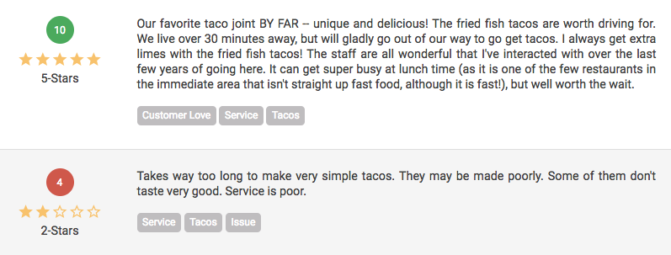
MANAGE
      Identify themes with
      Auto-Tagging
        Create themes by building tags from specific keywords. Auto-Tagging automatically applies tags to reviews help you to uncover valuable insights by understanding key areas of the experience.
        Build custom “Tag Widgets” to display content specific reviews on your own website.

Slide 25
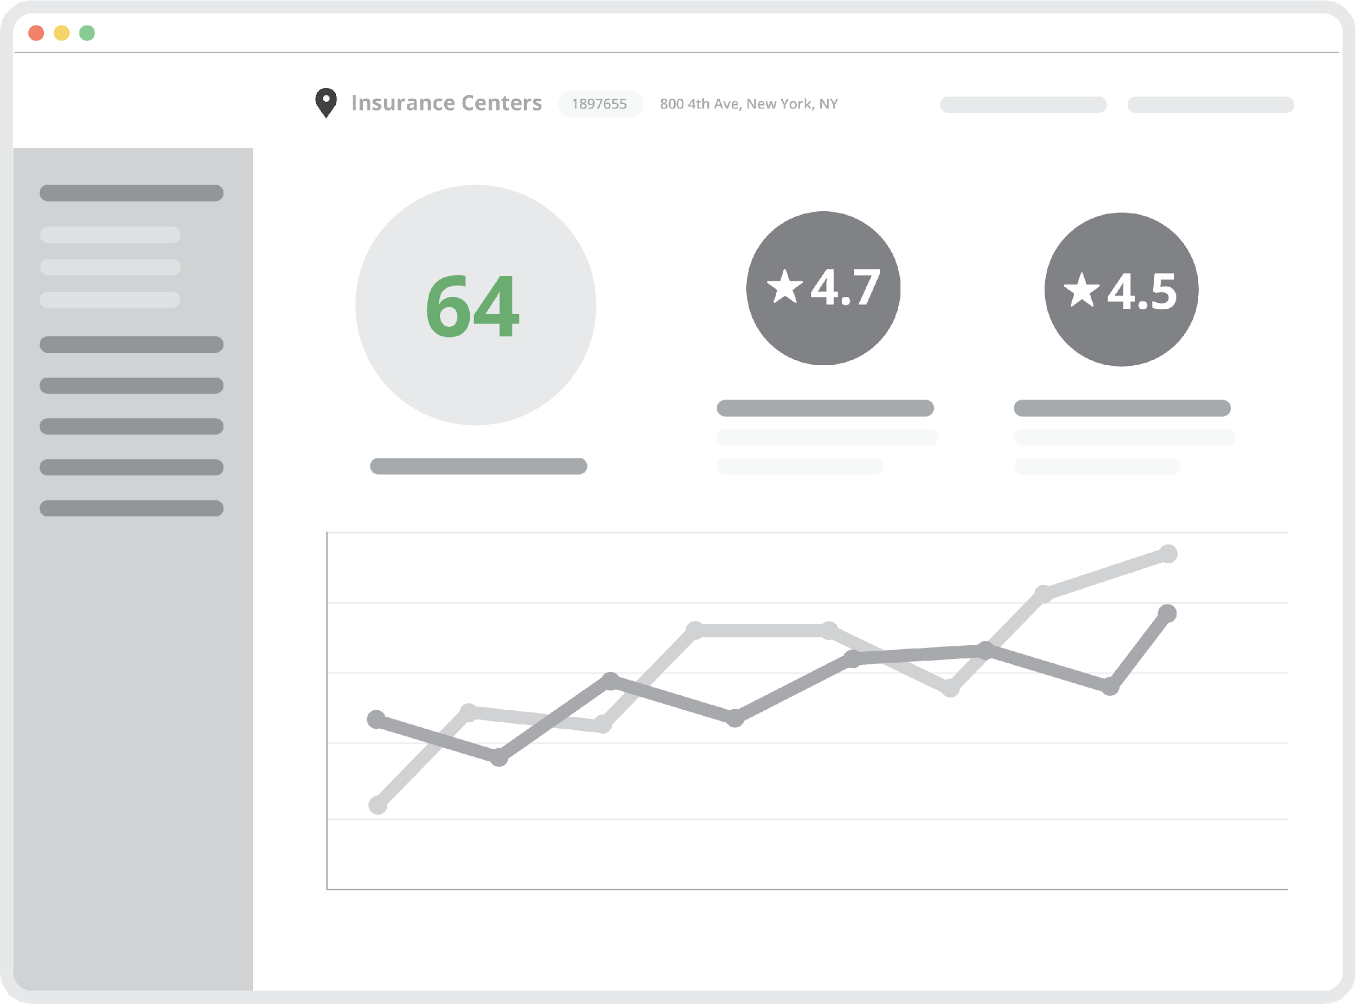
MANAGE
      A full reporting suite to view
      the data you need to grow
        Featuring a robust set of reports, you can view data in many ways to manage your customer’s experience.
        Benefit from the control of date ranges, actions, review sites, rating types, tags and more to understand your business better every day.

Slide 26
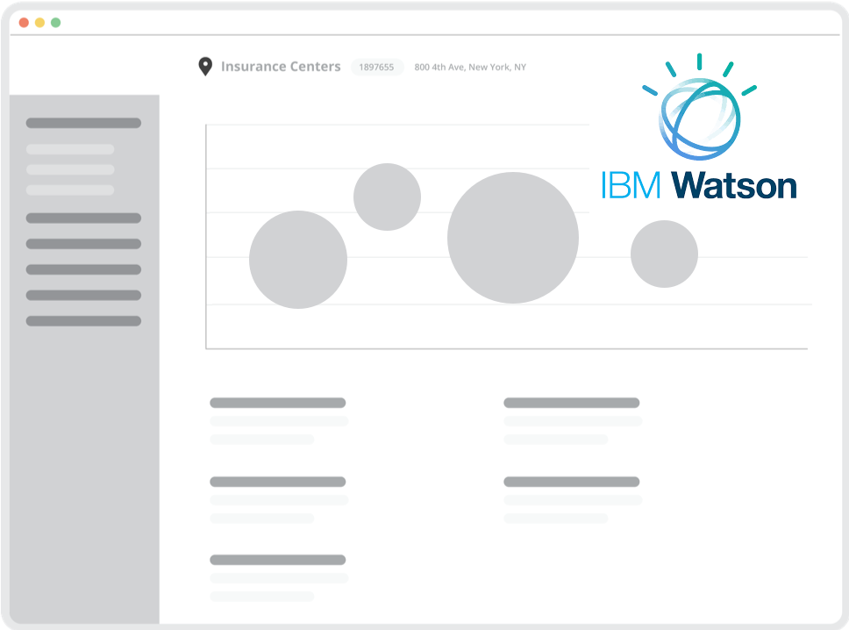
MANAGE
      Discover what you don’t know with Insights Report
        Insights Report uses Artificial Intelligence and Natural Language Processing to uncover keywords, impact, sentiment, and trends in your reviews powered by IBM Watson.

Slide 27
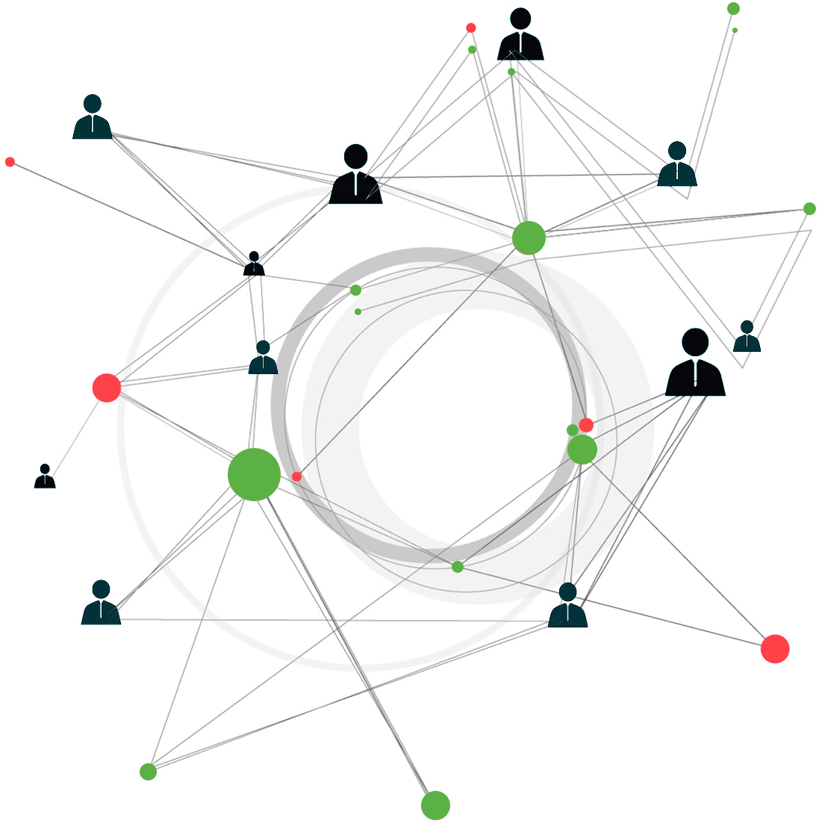
MANAGE
      Insights Report
        Discover valuable review details and trends thanks to the artificial intelligence (AI) power of IBM’s Watson.
        The Insights Report analyzes all of your review data for:
        •Keyword and Tag sentiment
        •Review rating impact
        •Trends

Slide 28

MARKET
      Fuel your marketing with customer generated content to
      showcase reviews, improve SEO, and win new customers.

Slide 29
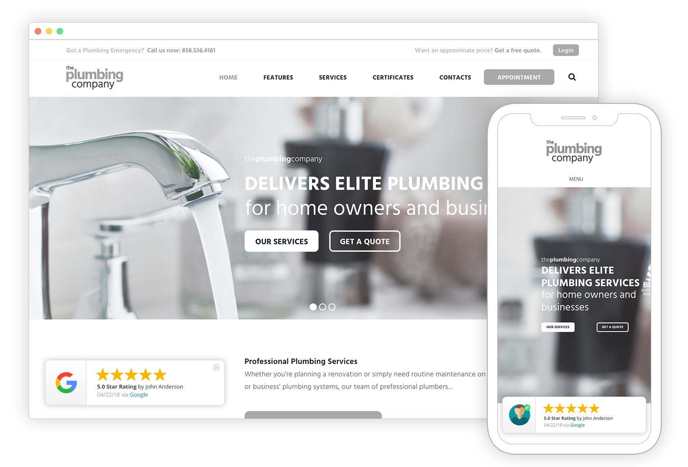
MARKET
      Conversion Pop-up adds social proof to your website
        Bring a visually appealing display of your latest ratings and reviews right to any page of your website.
        Build social trust and convert more website visitors to contacts by leading with reputation.

Slide 30
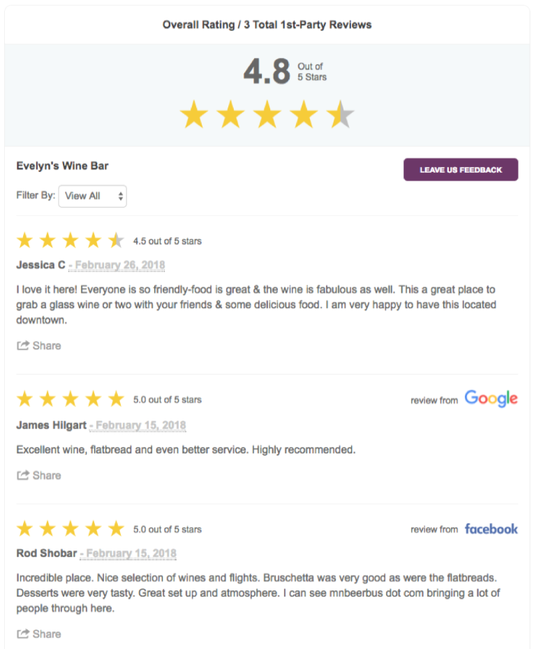
MARKET
      Get the BEST Review Widget on the market
        Review Widget is the one everyone else is chasing.
        Easily integrated into your website, Review Widget displays selected 1st-party reviews (with review schema for SEO benefits) as well as selected 3rd-party reviews for additional social trust.
        Numerous settings, options and more.

Slide 31
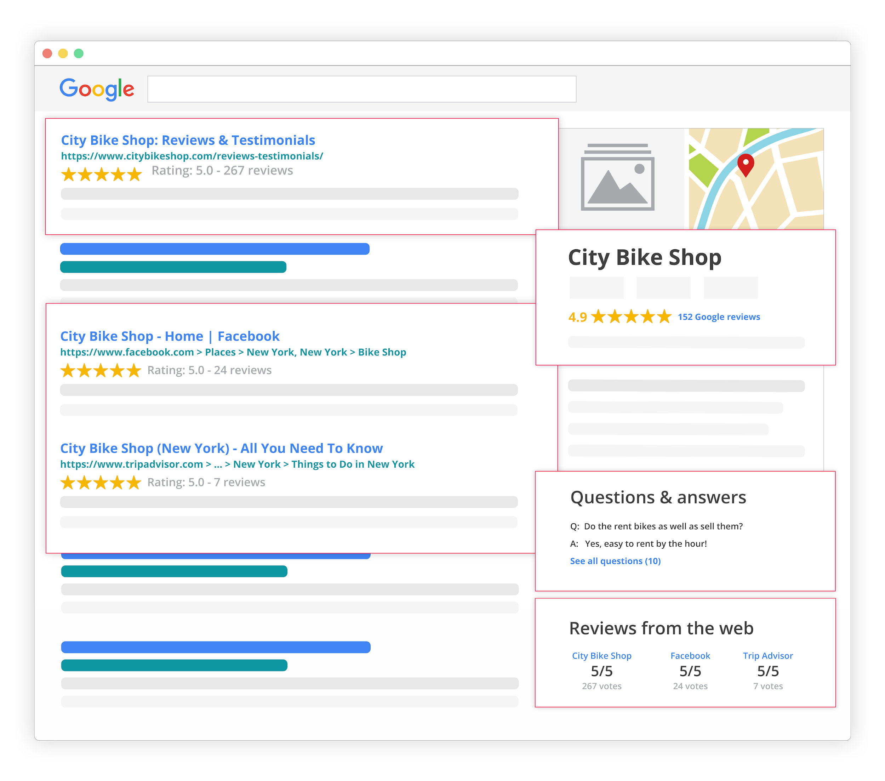
MARKET
      Manage your reputation in search results
        We influence the majority of reputation results from Google Searches about your business.
        Because the Review Widget includes review schema you can reap the benefits of SEO and enhanced search results to help you compete on search engine results pages.
        Review stars are important to consumer perception and increase click-thru rates.

Slide 32
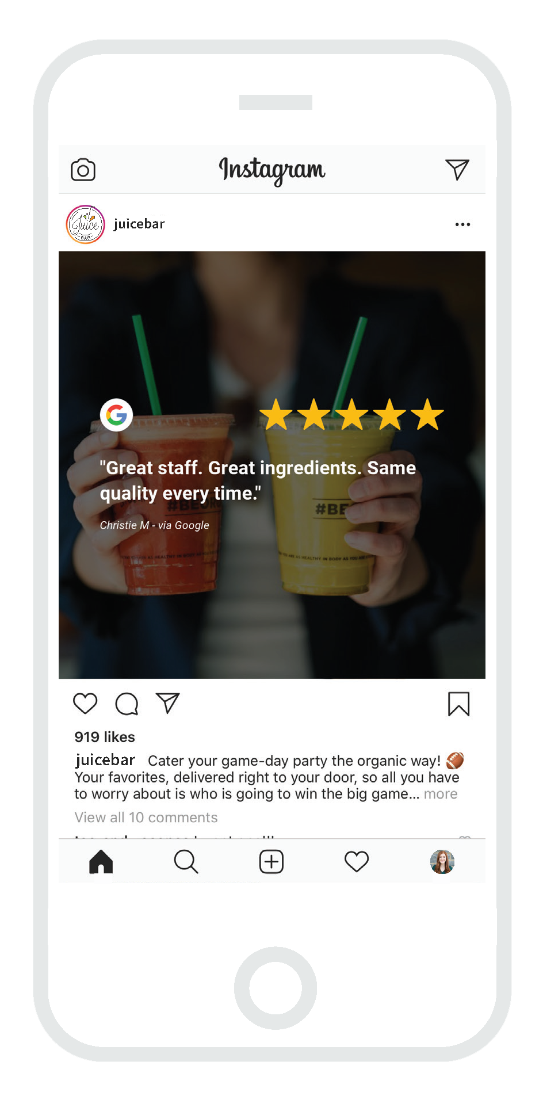


MARKET
      Social Sharing
        Turn your 1st and 3rd-party reviews into eye-catching social media graphics using the image generator.
        Create custom visual themes to brand images and stand out to your audience.
        Post directly to Google and Facebook and download images for other social channels.

Slide 33

      Let's power your business with reviews and customer feedback. You can CAPTURE, MANAGE and MARKET your customer experience starting today.

Slide 34

THANK YOU
  Any Questions?

